Slide 1






Master Thesis Collequim submitted as a partial requirement for the degree of:
M.Eng., Embedded Systems for Mechatronics
Author of the work:
Mustafa Özçelikörs
Supervision by:
M.Eng. Robert Höttger,
Prof. Carsten Wolff
Acknowledgements
This work is completed for FH Dortmund IDiAL within APP4MC project as a master thesis project. The project is funded by BMBF Fund.Nb. 01-S14029K under Project AMALTHEA4public. A4MCAR project is also granted by The Eclipse Foundation and Google Inc. during Google Summer of Code 2017.

Slide 2
Contents
Introduction
Overview
Problem and Solution
Motivations
Goals and Contributions
Events and Publications
Parallel Programming Basics
Definitions
Design Techniques
Synchronization
Scheduling Analysis
Optimization
APP4MC
Design and Implementation of A4MCAR
Overall Look
Basic Infrastructure
Low-level Applications
High-level Applications
Web Interface
Android App
Efforts Toward Tracing
Efforts Toward Software Distribution
Reducing Power Consumption
Results
Distributions
Comparison
Conclusions
Extra: Rover Project

Slide 3
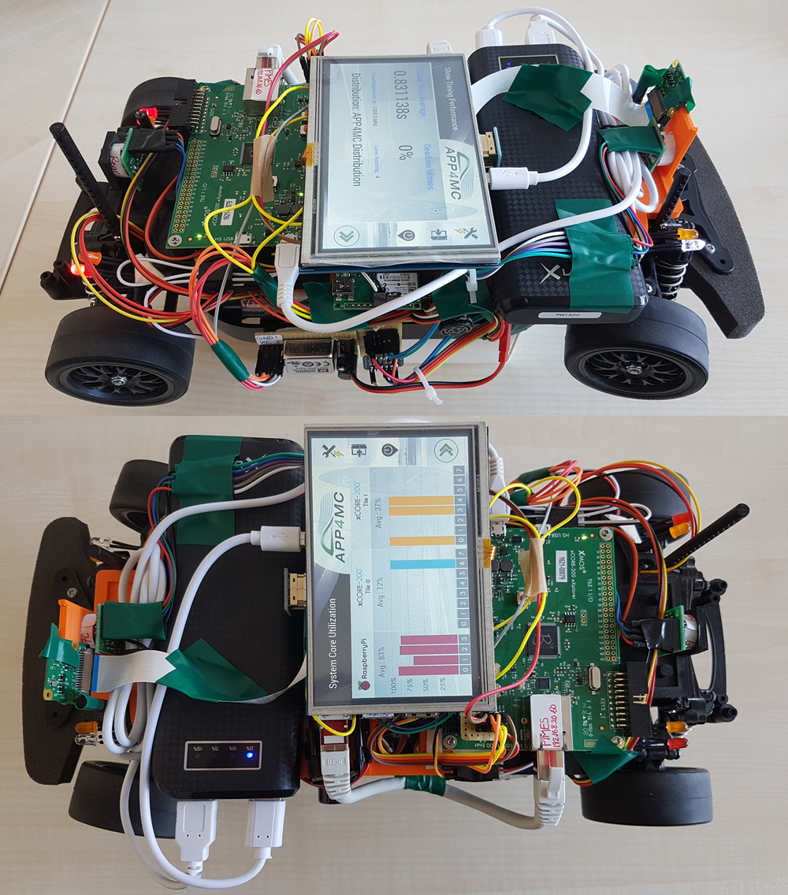
Introduction
Overview
APP4MC
Embedded-multicore system design platform
Automotive domain
Sw deployment through Sw and Hw modeling
A4MCAR
Demonstrator to APP4MC
Features schedulable and traceable software
Has many applications
Problem and Solution
Distribute software efficiently between cores, considering optimization goals
As a solution, APP4MC results are evaluated and presented.

Slide 4
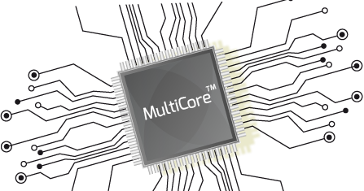

Introduction
Motivations
Importance of parallel programming
Evolution of algorithms, applications, and application domains.
Evolution of new trends in parallel computing
Evolution of multi-core processors
Model-based development
Developing open-source!!!

Slide 5
Introduction
Goals and Contributions of A4MCAR
Achieving a base platform for multi-threaded and multi-process development that is schedulable and traceable
Developing scripts / tool support for several platforms including Linux for profiling, tracing and modeling in order to make demonstration with APP4MC easier.
Researching to achieve better software utilization through APP4MC in order to get lower energy consumption.
Finding out evaluation metrics and methods for parallel software evaluation using real-time and offline (using e.g. TraceCompass) approaches.
Evaluation of several software distributions to make experiments regarding parallel software as well as to test and validate the performance of APP4MC.

Slide 6




Introduction
Events and Publications
IDAACS ’17 Paper “Constrained mixed-critical parallelization for distributed heterogeneous systems”
EclipseCon conferences Europe 2016 IoT Day, and France 2017 Unconference.
Eclipse Foundation GmbH Hackathons I and II
International Research Conference Dortmund 2017 Demonstration
Google Summer of Code 2017 successful participation

Slide 7
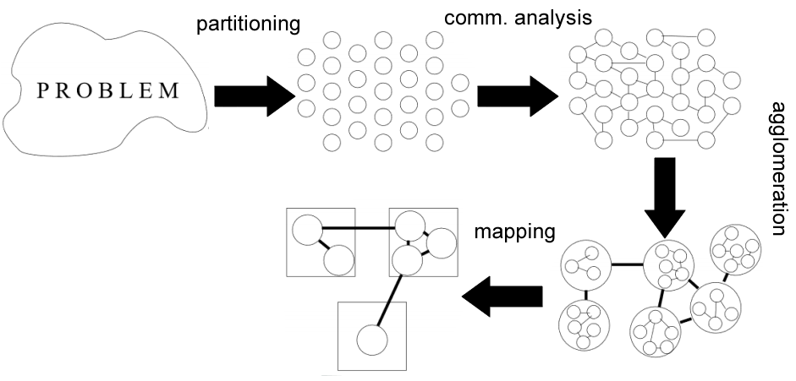
Parallel Programming Basics
Basics
Design Techniques

Slide 8
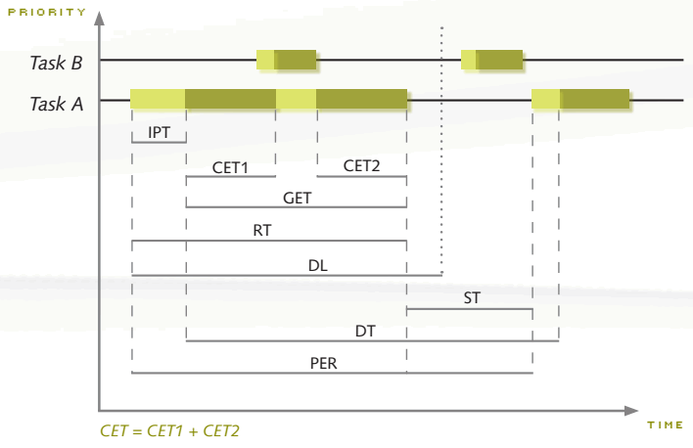
Parallel Programming Basics
Synchronization
Scheduling Analysis

Slide 9
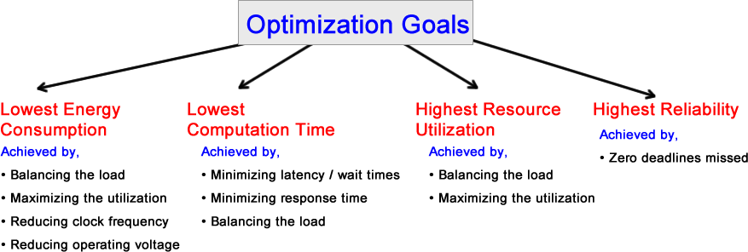
Parallel Programming Basics
Optimization

Slide 10
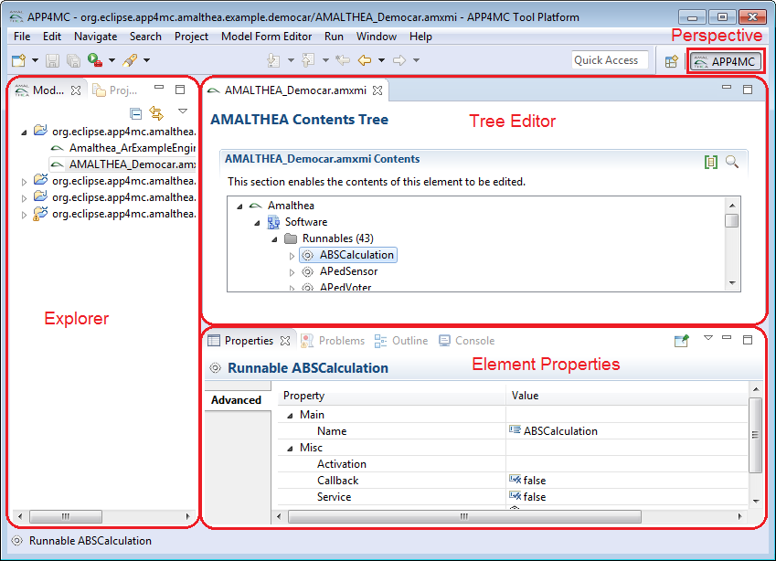
APP4MC
What is APP4MC?
Design Flow with APP4MC
Modeling
AMALTHEA models
Partitioning
ESSP, CPP
Generating Tasks
Mapping
ILP-based, GA-based load balancing
Reducing computation time
Optimization towards energy consumption

Slide 11
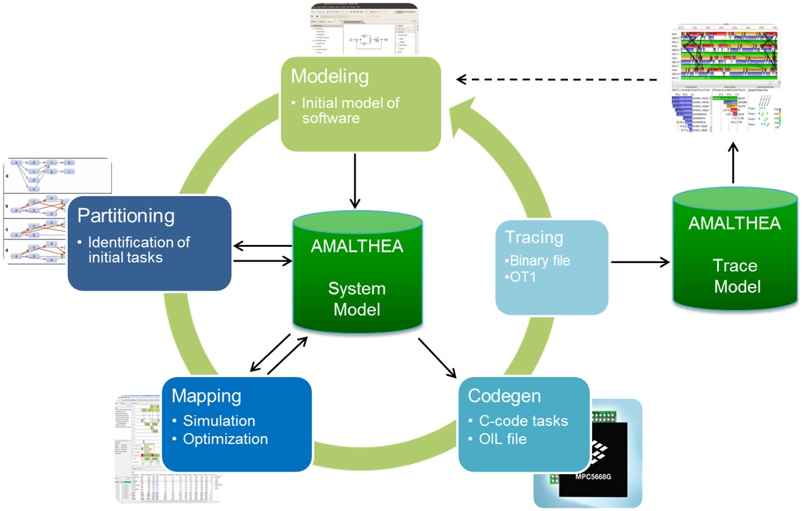
APP4MC
Design Steps

Slide 12
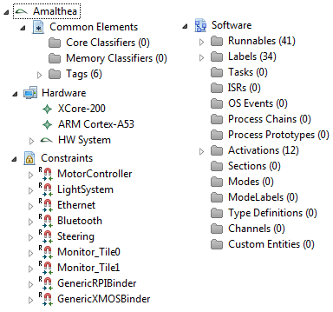
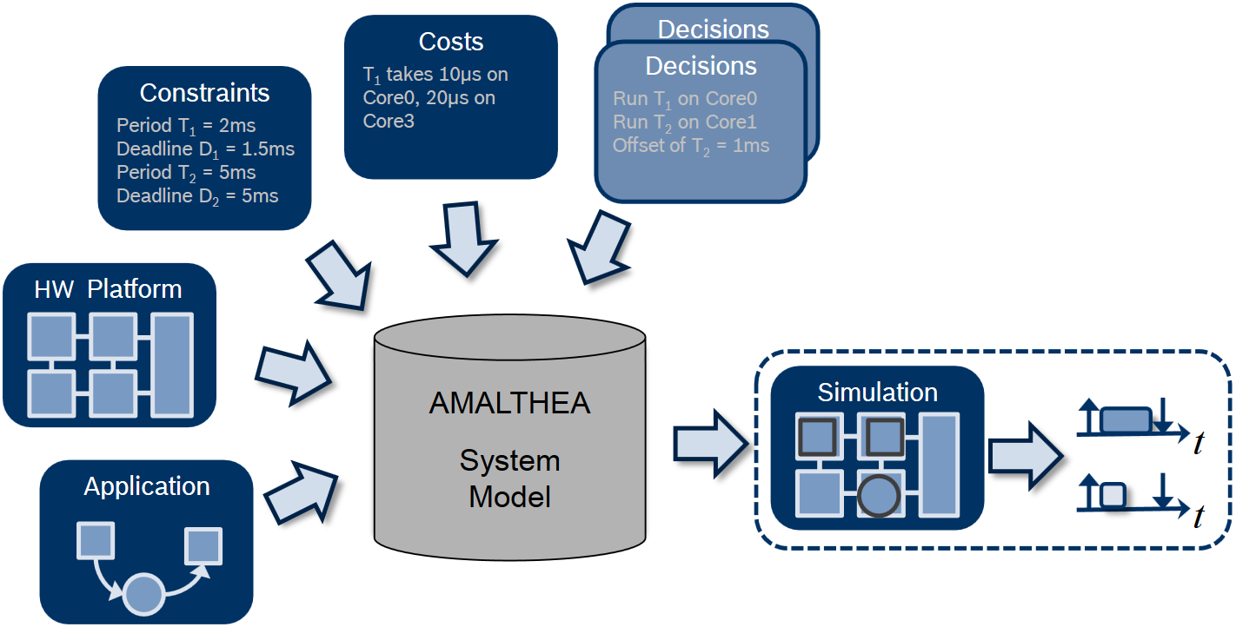
APP4MC
Modeling

Slide 13
APP4MC
Partitioning

Slide 14
APP4MC
Mapping

Slide 15
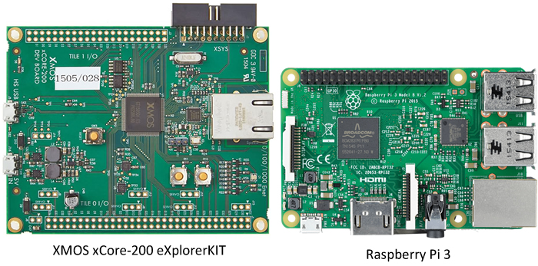
Design and Implementation of A4MCAR
Overall Look to A4MCAR
Introduction
Two multi-core controllers
Apps such as:
Android phone/bluetooth control, web interface front-end, Touchscreen display, Sensor applications, Image processing

Slide 16
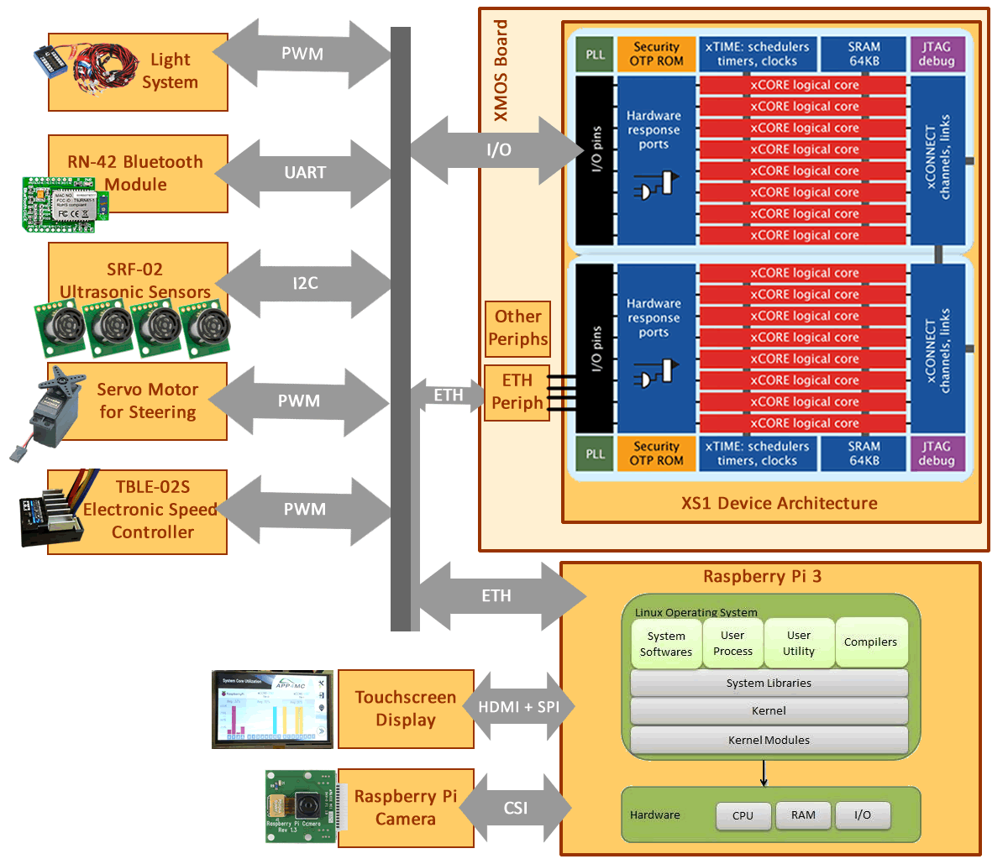
Design and Implementation of A4MCAR
Overall Look to A4MCAR
Hardware
Low-level Module
XMOS xCORE eXplorerKIT
4x SRF-02 Sonar Sensor
TBLE-02S Speed Controller
Servo Motor for Steering
RN-42 Bluetooth Module
Lighting Module
High-level Module
Raspberry Pi (Raspbian/Linux)
Touchscreen Display (HDMI+SPI)
Rpi Camera

Slide 17
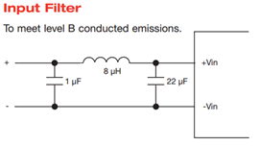
Design and Implementation of A4MCAR
Overall Look to A4MCAR
Safety Considerations
Properly reverse engineering TBLE-02S Electronic Speed Controller
3V to 5V logic converters (I2c-tolerant)
Boards and other components are isolated by using seperate batteries. (7.2V and 5V)
Isolated 5V converter
Emission specification conformed
Implemented proper braking for a brushed motor using a relay switch

Slide 18
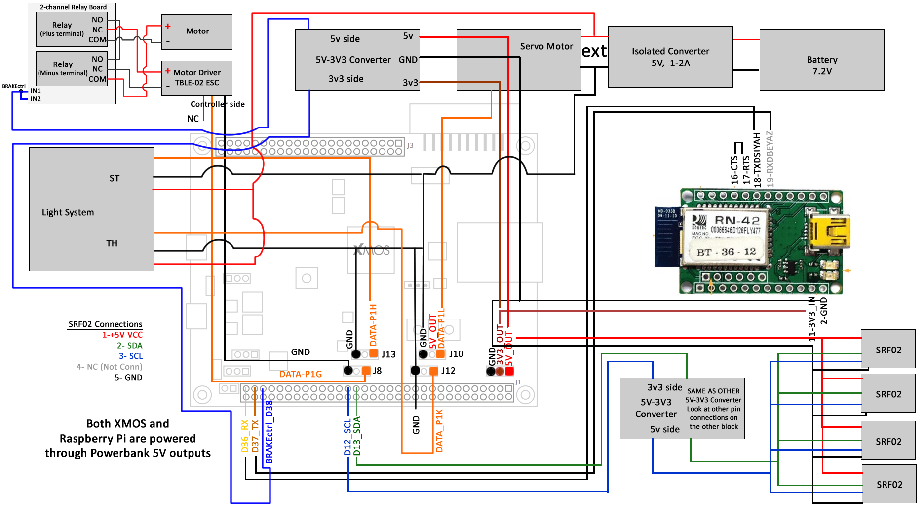
Design and Implementation of A4MCAR
Overall Look to A4MCAR
Hardware Schematics

Slide 19
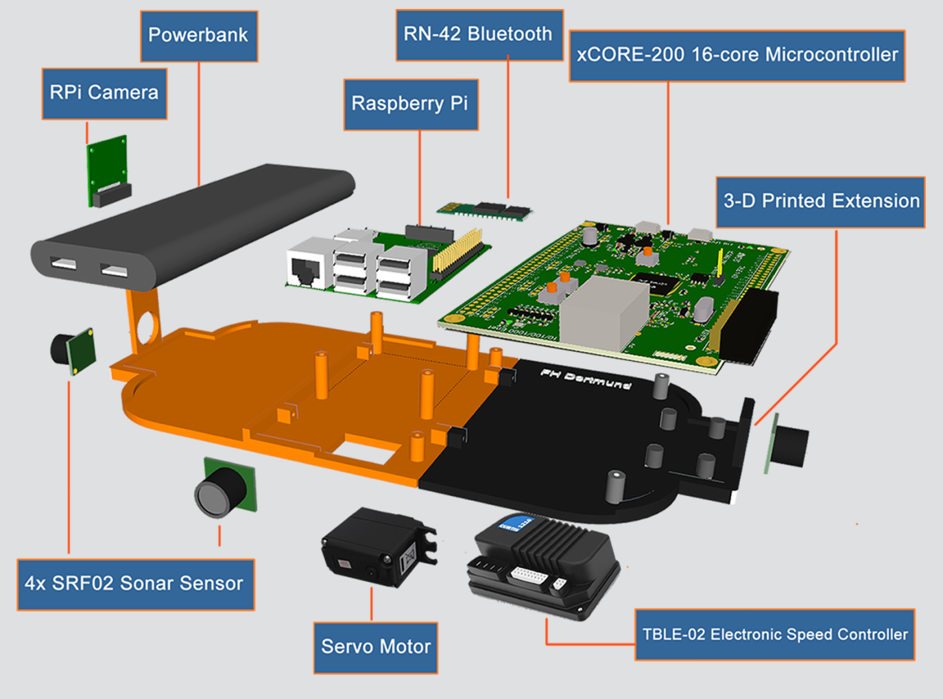
Design and Implementation of A4MCAR
Overall Look to A4MCAR
Mechanical Design
.STL output from 3D design software
3D printed layer

Slide 20
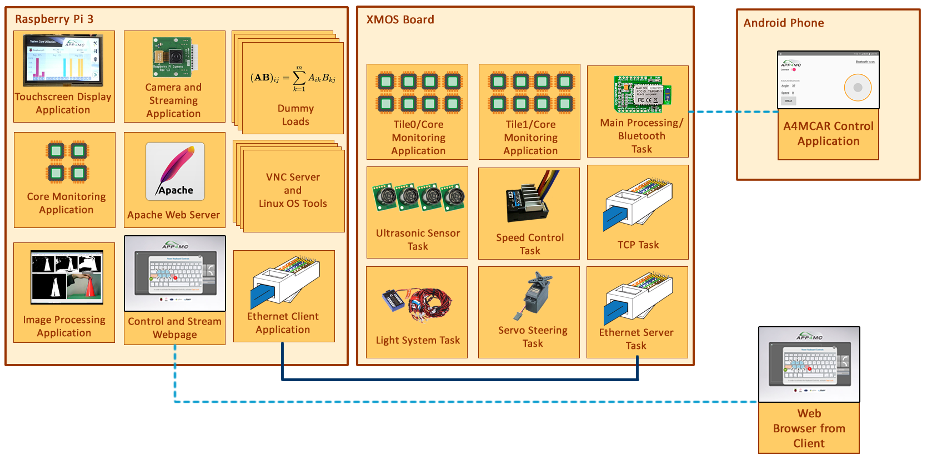
Design and Implementation of A4MCAR
Overall Look to A4MCAR
Software

Slide 21
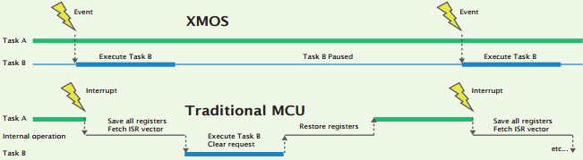
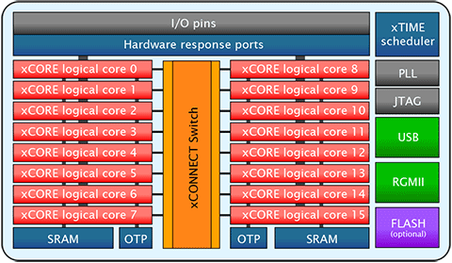
Design and Implementation of A4MCAR
How does Infrastructure look like?
xCORE-200 16-core microcontroller
XMOS / xTIME Scheduler
Round robin
Traditional MCU /RTOS
Tile 0
Tile 1

Slide 22
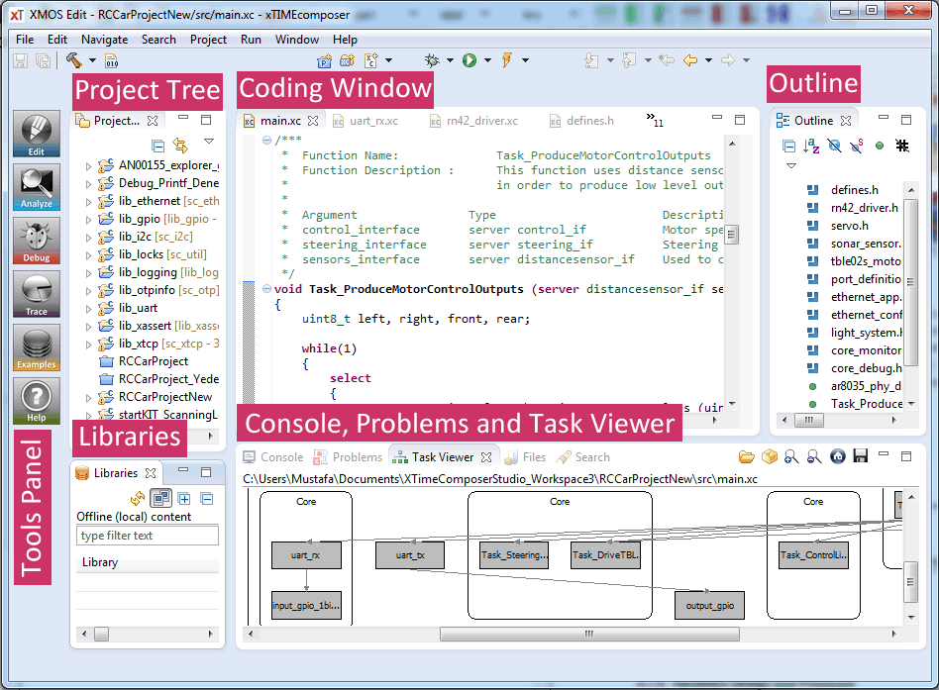
Design and Implementation of A4MCAR
How does Infrastructure look like?
xCORE-200 16-core microcontroller
xTIME Composer

Slide 23
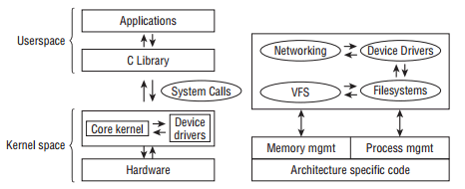
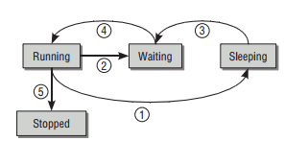
Design and Implementation of A4MCAR
How does Infrastructure look like?
Raspberry Pi (Raspbian/Linux)
GNU/Linux Architecture
Process/Thread Lifecycle
Completely Fair Scheduling
(CFS)

Slide 24
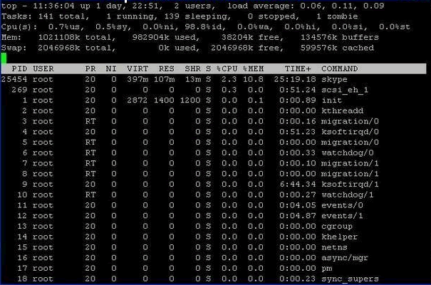
Design and Implementation of A4MCAR
How does Infrastructure look like?
Raspberry Pi (Raspbian/Linux)
Developing in Raspberry Pi
SSH connection from PC
PuTTy (Shell)
TightVNC (Desktop)
Eclipse IDE (Remote Compilation/Debugging)
Editors
Any GNU/Linux Terminal software
Eclipse IDE
Emacs (Powerful dev. Env.)

Slide 25
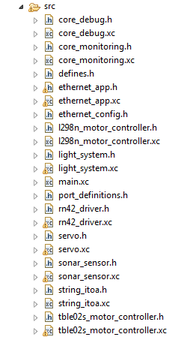
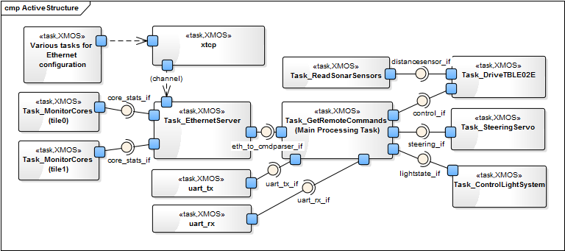
Design and Implementation of A4MCAR
Low-level Module Tasks
Overview

Slide 26
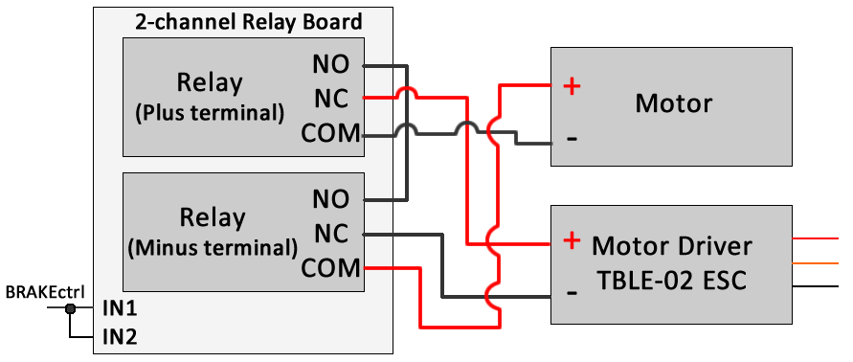
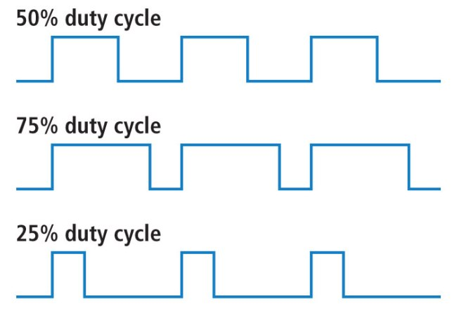
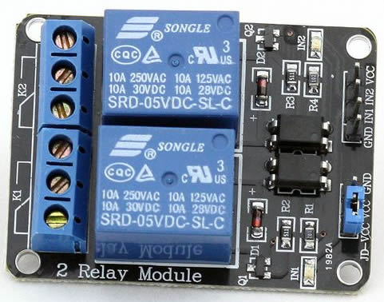
Design and Implementation of A4MCAR
Low-level Module Tasks
Acceleration/Braking
PWM-based ESC drive
Timer event in XMOS
20ms pulse period
Relay-based braking

Slide 27
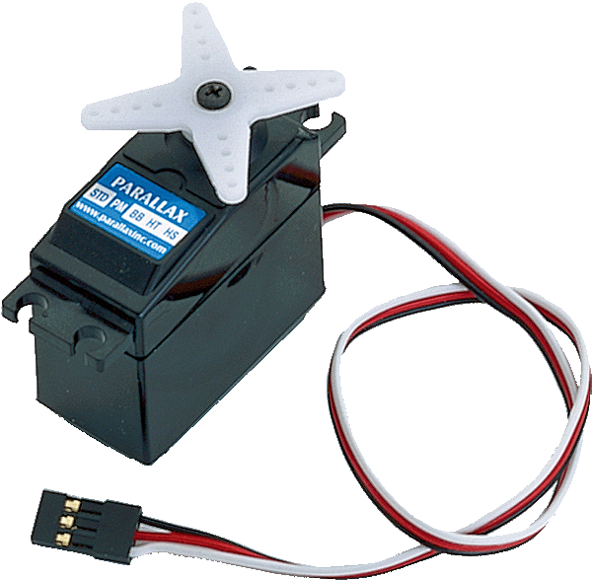
Design and Implementation of A4MCAR
Low-level Module Tasks
Steering
Servo motor
Driven with PWM pulse
Timer event in XMOS
20ms pulse period
1-1.5ms -> Left side
1.5ms-2.0ms -> Right side

Slide 28
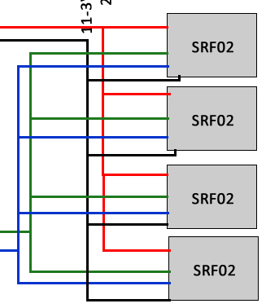
Design and Implementation of A4MCAR
Low-level Module Tasks
Proximity Sensing
SRF-02 Ultrasonic Sensor
I2C network with 4 sensors
Periodically polling information (0.2 sec)
Timer event
VCC
GND
SDA
SCL

Slide 29
Design and Implementation of A4MCAR
Low-level Module Tasks
Light System
Lighting module from Conrad
PWM-driven
Specified pulses are applied.

Slide 30
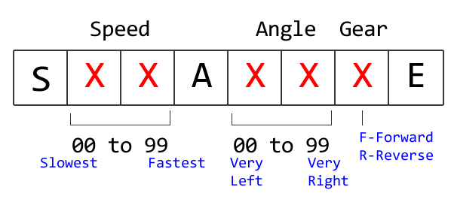
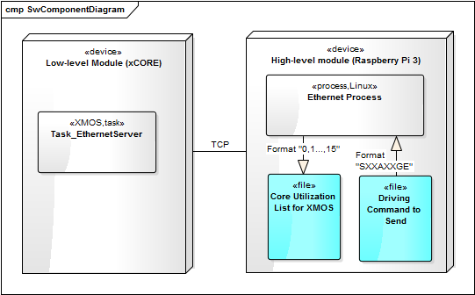
Design and Implementation of A4MCAR
Low-level Module Tasks
Bluetooth Task
RN-42 Bluetooth module
Communicates using UART
Slave mode
Configuration function implemented (pwd).
Events in Task:
Timer event to process received command
UART ready event
Override command event

Slide 31
Design and Implementation of A4MCAR
Low-level Module Tasks
TCP Server Task
Many concurrent tasks implement PHY driver and TCP protocol
TCP Server task
Periodically sends core information to HLM
Receives when HLM sends a driving command

Slide 32
Design and Implementation of A4MCAR
Low-level Module Tasks
Core Monitoring Task
Instantiated for two seperate tiles.
Timer event polls internal registers for each core to see if cores are busy
Averaging over time gives reasonable core util information
Counters for busy and idle cycles are used.

Slide 33
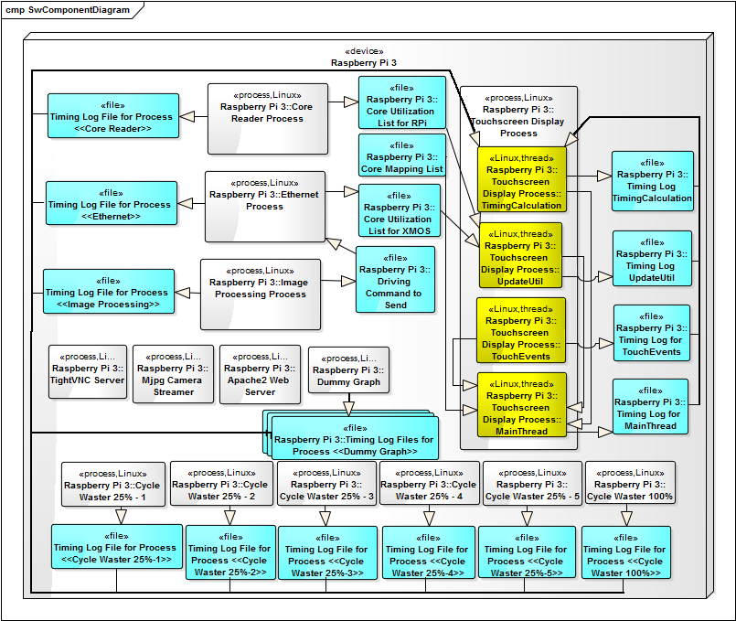
Design and Implementation of A4MCAR
High-level Module Tasks
Overview

Slide 34
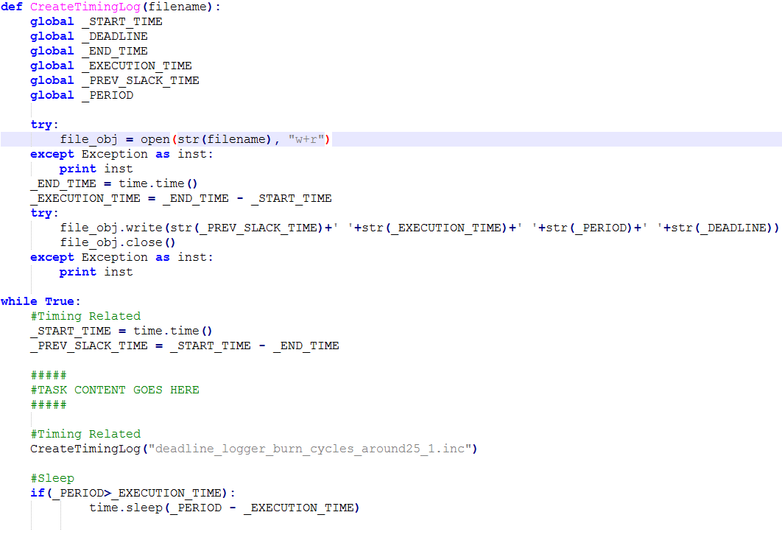
Design and Implementation of A4MCAR
High-level Module Tasks
Overview
Schedulability and traceability (in C++ and Python)

Slide 35
Design and Implementation of A4MCAR
High-level Module Tasks
1. Core Reader
Uses 3rd party: ‘psutil’ package from Python
Logs each core utilization
2. TCP Client
Uses Python’s ‘socket’ library
Non-blocking receive
Periodically (every 3s) transmit
Uses logs to write and read infos

Slide 36
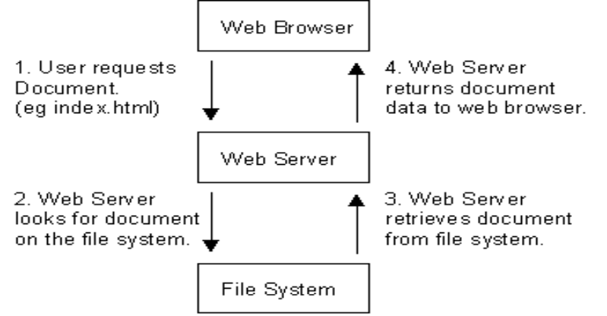
Design and Implementation of A4MCAR
High-level Module Tasks
3. Web Server (apache2)
Responsible for processing HTTP requests
Delivering HTTP responses
HTML, CSS, JavaScript – based web pages
PHP-based server pages and databases

Slide 37
Design and Implementation of A4MCAR
High-level Module Tasks
3. Web Server (apache2)
Responsible for processing HTTP requests
Delivering HTTP responses
HTML, CSS, JavaScript – based web pages
PHP-based server pages and databases

Slide 38
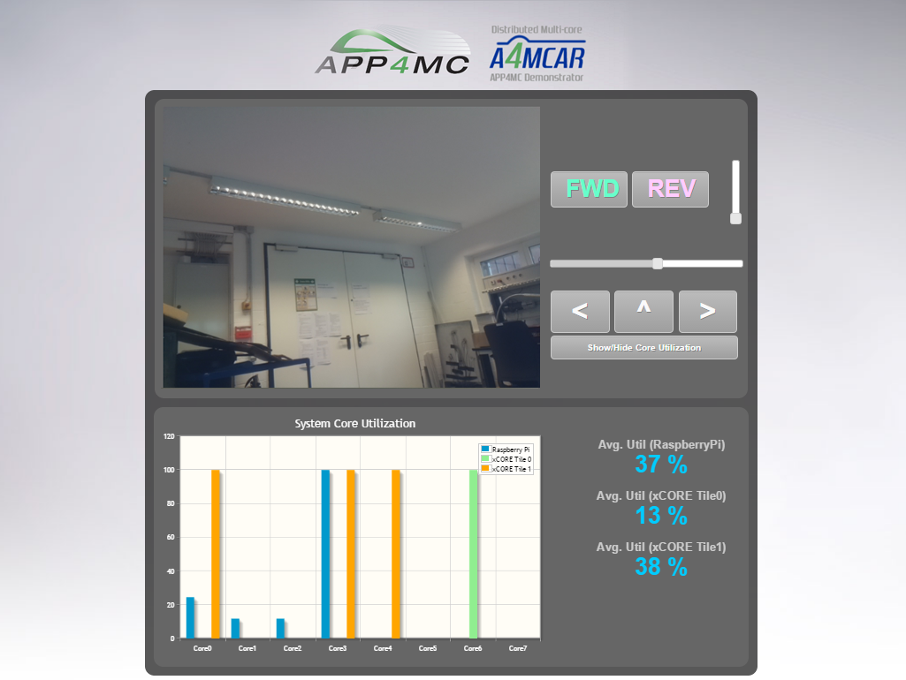
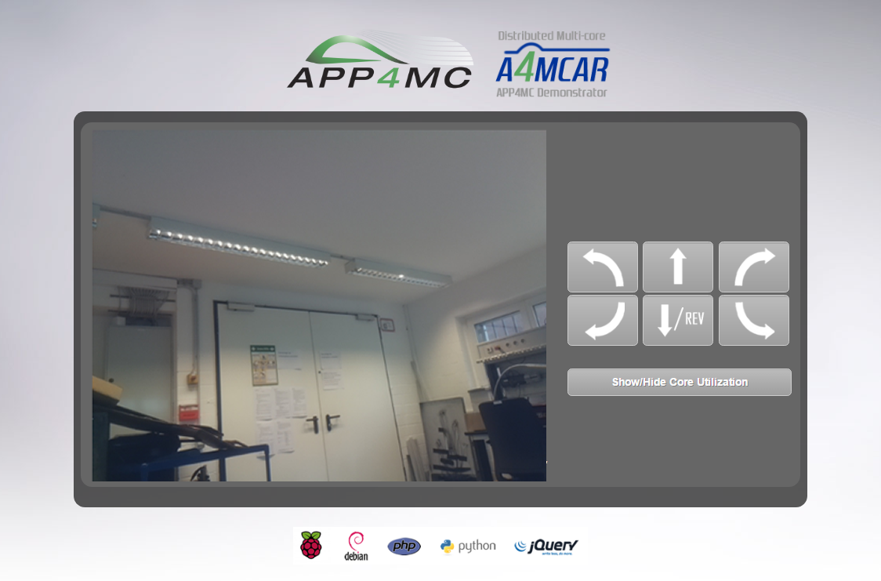
Design and Implementation of A4MCAR
High-level Module Tasks
3. Web Server (apache2)
Web Front-End Design and Implementation
Technologies Used: HTML, CSS, PHP, JavaScript, AJAX, jQuery, Python

Slide 39
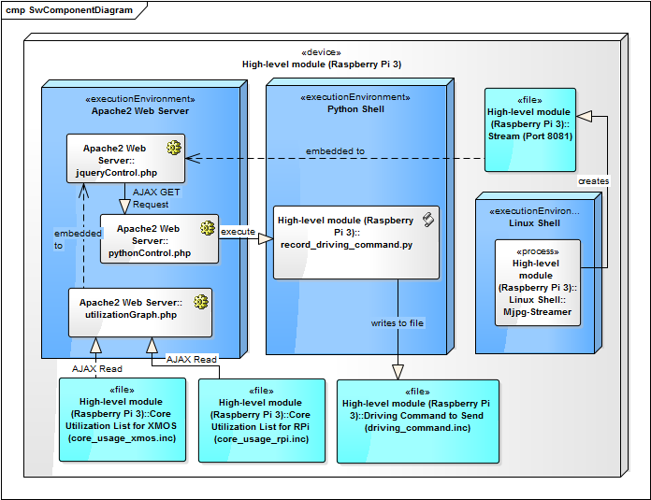
Design and Implementation of A4MCAR
High-level Module Tasks
3. Web Server (apache2)
Controlling A4MCAR via Web interface

Slide 40
Design and Implementation of A4MCAR
High-level Module Tasks
3. Web Server (apache2)
Core Utilization Display
jqPlot

Slide 41
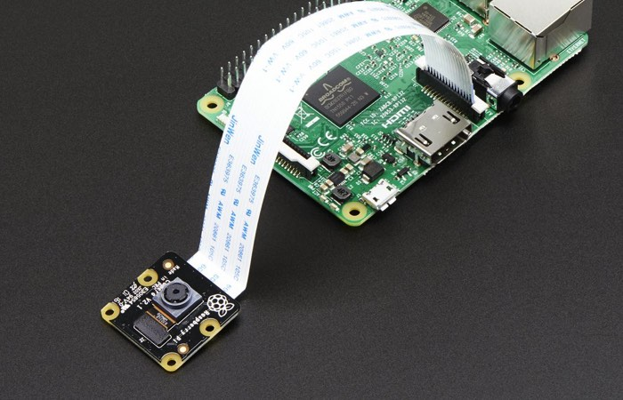
Design and Implementation of A4MCAR
High-level Module Tasks
4. Camera Streaming
mjpg_streamer
Experimental streaming for Raspicam
Resolution: 640 x 480
Fps : 30
Bash script to start

Slide 42
Design and Implementation of A4MCAR
High-level Module Tasks
5. Dummy Loads
x

Slide 43
Design and Implementation of A4MCAR
High-level Module Tasks
6. Dummy Graph
x

